Slide 1
Data Analysis on Upfront Pricing

Slide 2
STEPS FOLLOWED
EXPLORING THE DATA
CHECKING THE NA VALUES IN DATA
REMOVING UNWANTED COLUMNS FROM THE DATA SET
CHECKED THE CORRELATION BETWEEN THE VARIABLES
CHECKING THE WHETHER THE OUTLIERS ARE PRESENT AND REMOVING THEM
CREATING A TRAIN AND TEST DATASET
CHECKING WHICH MODEL FITS WELL FOR THE DATA(DUE TO REGRESSION)
CHECKING THE ACCURACY OF THE MODEL
GRAPHICAL VIEW OF ACTUAL AND PREDICTED VALUES TO GET A BETTER VIEW OF THE ANALYSIS.

Slide 3
DATA EXPLORATION
The Data had 4943 rows and 26 columns.
Checked which column can be taken as the dependent variable.
Used the correlation plot to determine which variables are highly correlated.
Removed the columns which were not required for the building the model
The NA values where present in the dataset so replaced them with the Mean Values.
Checked if the outliers are present in the data using the box plot and tried to remove them by using the Quartile Calculation and derived with the upper limit and the lower limit so that the values won't go beyond the detected value.

Slide 4
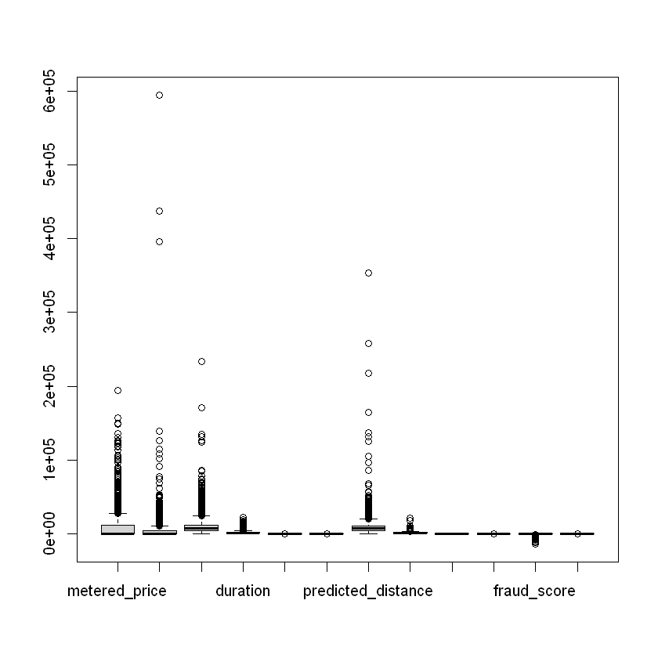
BOX PLOT FOR DETECTING THE OUTLIERS
From the graph we can infer that the outliers are present in the third quartile and first quartile for the variables

Slide 5
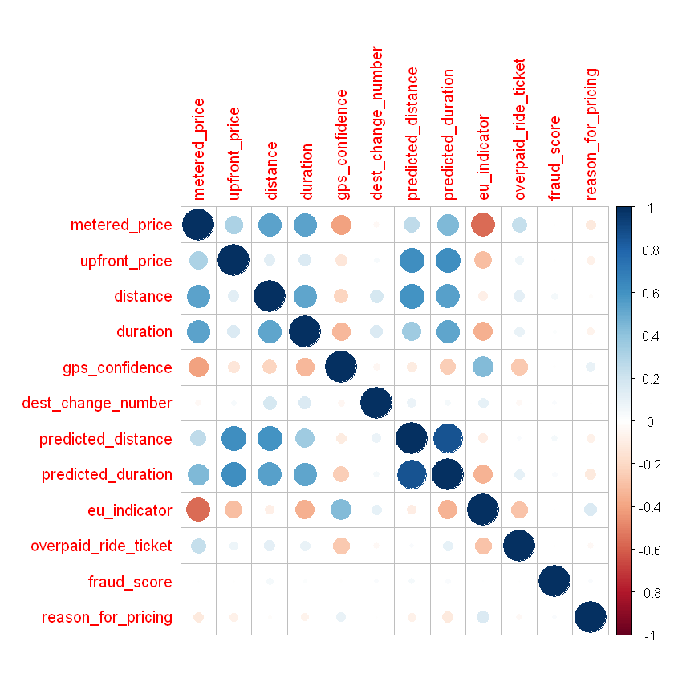
CORRELATION PLOT
From the Graph we can infer that
Predicted _distance , Predicted Duration are having high correlation

Slide 6
TRAIN & TEST SPLIT DATA & MODEL BUILDING
Splitting the data into Train & Test Data with the split ration of 70%
Train Data volume is 70%.
Test Data volume is 30%.
Since it’s a regression analysis tried the model using the Linear regression.
The Dependent Variable taken was Metered Price
The model did not perform well since the Multiple R squared was not close to 1.
So checked for the columns and there significance.
Then tried using the Random forest modelling.

Slide 7
RESULT AFTER MODELLING
After removing the outliers and training the model with Random Forest was the following result.
By using all the Independent variables present in the Data & below is the result
mtry | RMSE | Rsquared
2 | 1539.8952 | 0.9215841
6 | 896.4808 | 0.9518155
11 | 938.0028 | 0.947251

Slide 8
RESULT AFTER REMOVING SOME DEPENDENT VARIABLES
Without removing the outliers and removing the dependent variables Upfront_price, Predicted distance, Predicted Duration. Below is the result
mtry ​ | RMSE​ | Rsquared​ ​
2​ | 5485.001 | 0.9048657
6​ | 4489.749 | 0.9259880
11​ | 4587.619 | 0.9208330

Slide 9
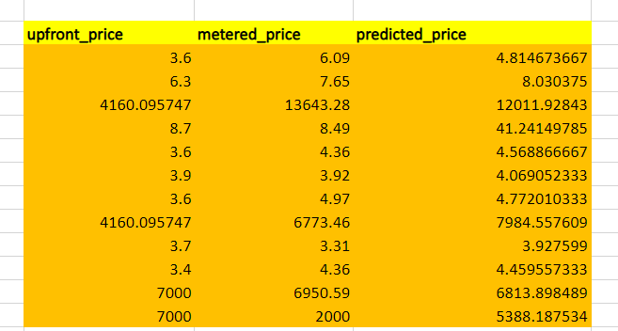
PREDICTING THE MODEL WITH THE TEST DATA
Predicted the model with the test data got the results close to thew
Sample of the values which we got after predicting doing outlier treatment.

Slide 10
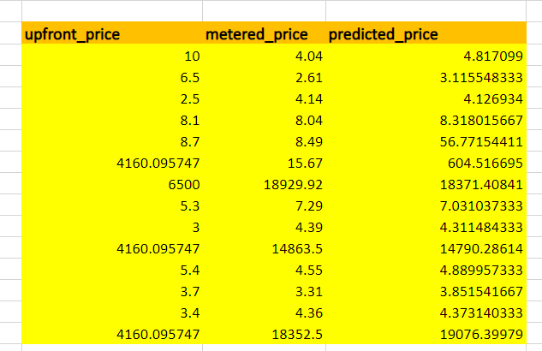
PREDICTING THE MODEL WITH THE TEST DATA (Without Outlier Treatment)
Predicted the model with the test data got the results close to the metered price as expected.
Sample of the values which we got after predicting without doing outlier treatment.

Slide 11
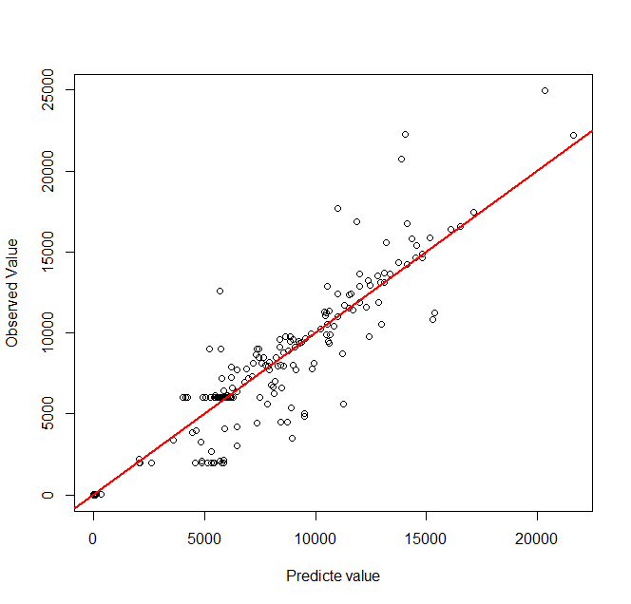
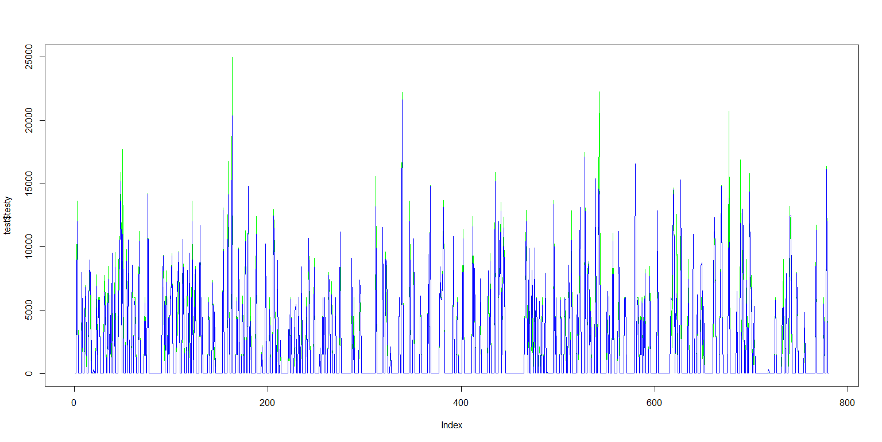
GRAPHICAL REPRESENTATION.
The graph shows how well the data is aligned with the actual and the predicted value.

Slide 12
THANK YOU

